Slide 1
Beyond Vectors
Hung-yi Lee
Notes:
Appendix: P388, 389

Slide 2
Introduction
Many things can be considered as “vectors”.
  E.g. a function can be regarded as a vector
We can apply the concept we learned on those “vectors”.
  Linear combination
  Span
  Basis
  Orthogonal ……
Reference: Chapter 6

Slide 3
Are they vectors?

Slide 4



Are they vectors?
A matrix
A linear transform
A polynomial
$$\left[\begin{aligned}1 \\ 2 \\ 3 \\ 4\end{aligned}\right]$$
$$A=\left[\begin{matrix}1 & 2 \\ 3 & 4\end{matrix}\right]$$
$$p\left(x\right)=a_{0}+a_{1}x+⋯+a_{n}x^{n}$$
$$\left[\begin{aligned}a_{0} \\ a_{1} \\ ⋮ \\ a_{n}\end{aligned}\right]$$

Slide 5






Are they vectors?
What is the zero vector?
Any function is a vector?
$$v=\left[\begin{aligned}⋮ \\ ? \\ ⋮\end{aligned}\right]$$
$$f\left(t\right)=e^{t}$$
$$g=\left[\begin{aligned}⋮ \\ ? \\ ⋮\end{aligned}\right]$$
$$g\left(t\right)=t^{2}−1$$
$$h\left(t\right)=e^{t}+t^{2}−1$$
$$v+g$$

Slide 6
What is a vector?
R^{n} is a
vector space
If a set of objects V is a vector space, then the objects are “vectors”.
Vector space:
  There are operations called “addition” and “scalar multiplication”.
  u, v and w are in V, and a and b are scalars. u+v and au are unique elements of V
The following axioms hold:
  u + v = v + u, (u +v) + w = u +(v + w)
  There is a “zero vector” 0 in V such that u + 0 = u
  There is –u in V such that u +(-u) = 0
  1u = u, (ab)u = a(bu), a(u+v) = au +av, (a+b)u = au +bu
unique
Notes:
0, 0’
0 + 0’ = 0
0’ + 0 = 0’

Slide 7
Objects in Different Vector Spaces
In Vector Space R¹
1
2
3
(1,0)
(2,0)
(3,0)
In Vector Space R²

Slide 8






Objects in Different Vector Spaces
All the polynomials with degree less than or equal to 2 as a vector space
$$\left[\begin{aligned}1 \\ 0 \\ 0\end{aligned}\right]$$
$$\left[\begin{aligned}1 \\ 1 \\ 0\end{aligned}\right]$$
$$\left[\begin{aligned}1 \\ 1 \\ 1\end{aligned}\right]$$
$$f\left(t\right)=1$$
$$g\left(t\right)=t+1$$
$$h\left(t\right)=t^{2}+t+1$$
Vectors with infinite dimensions
All functions as a vector space
Notes:
Should I mention talr exniosn here

Slide 9
Subspaces

Slide 10
Review: Subspace
A vector set V is called a subspace if it has the following three properties:
1. The zero vector 0 belongs to V
2. If u and w belong to V, then u+w belongs to V
3. If u belongs to V, and c is a scalar, then cu belongs to V
Closed under (vector) addition
Closed under scalar multiplication
Notes:
1. Is kind of redundent

Slide 11


Are they subspaces?
All the functions pass 0 at t₀
All the matrices whose trace equal to zero
All the matrices of the form
All the continuous functions
All the polynomials with degree n
All the polynomials with degree less than or equal to n
$$\left[\begin{matrix}a & a+b \\ b & 0\end{matrix}\right]$$
P: all polynomials, P_{n}: all polynomials with degree less than or equal to n

Slide 12
Linear Combination and Span

Slide 13
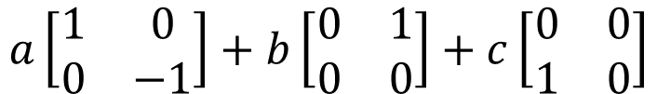
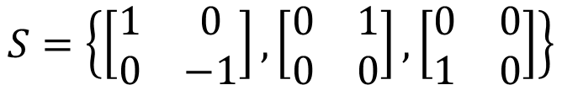

Linear Combination and Span
Matrices
$$S=\left\{\left[\begin{matrix}1 & 0 \\ 0 & −1\end{matrix}\right],\left[\begin{matrix}0 & 1 \\ 0 & 0\end{matrix}\right],\left[\begin{matrix}0 & 0 \\ 1 & 0\end{matrix}\right]\right\}$$
Linear combination with coefficient a, b, c
$$a\left[\begin{matrix}1 & 0 \\ 0 & −1\end{matrix}\right]+b\left[\begin{matrix}0 & 1 \\ 0 & 0\end{matrix}\right]+c\left[\begin{matrix}0 & 0 \\ 1 & 0\end{matrix}\right]$$
$$=\left[\begin{matrix}a & b \\ c & −a\end{matrix}\right]$$
What is Span S?
All 2x2 matrices whose trace equal to zero

Slide 14

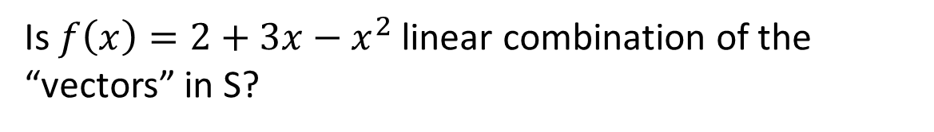





Linear Combination and Span
Polynomials
$$S=\left\{1,x,x^{2},x^{3} \right\}$$
Is $f\left(x\right)=2+3x−x^{2}$ linear combination of the “vectors” in S?
$$f\left(x\right)=2∙1+3∙x+\left(−1\right)∙x^{2}$$
$$Span\left\{1,x,x^{2},x^{3} \right\}$$
$$=P_{3}$$
$$Span\left\{1,x,⋯,x^{n},⋯\right\}$$
$$=P$$

Slide 15
Linear Transformation

Slide 16


Linear transformation
A mapping (function) T is called linear if for all “vectors” u, v and scalars c:
Preserving vector addition:
Preserving vector multiplication:
$$T\left(u+v\right)=T\left(u\right)+T\left(v\right)$$
$$T\left(cu\right)=cT\left(u\right)$$
Is matrix transpose linear?
Input: m x n matrices, output: n x m matrices

Slide 17

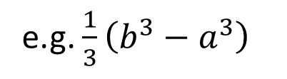
Linear transformation
linear?
Derivative:
Integral from a to b
Derivative
function f
function f’
e.g. x²
e.g. 2x
linear?
scalar
Integral
$$\int_{a}^{b}{f\left(t\right)dt}$$
function f
e.g. x²
(from a to b)
e.g. $\frac{1}{3}\left(b^{3}−a^{3}\right)$

Slide 18
Null Space and Range
Null Space
  The null space of T is the set of all vectors such that T(v)=0
  What is the null space of matrix transpose?
Range
  The range of T is the set of all images of T.
  That is, the set of all vectors T(v) for all v in the domain
  What is the range of matrix transpose?

Slide 19
One-to-one and Onto
U: M_{m×n} → M_{n×m} defined by U(A) = A^{T}.
  Is U one-to-one?
  Is U onto?
D: C∞ → C∞ defined by D( f ) = f ′
  Is D one-to-one?
  Is D onto?
D: P₃ → P₃ defined by D( f ) = f ′
  Is D one-to-one?
  Is D onto?
yes
yes
no
yes
no
no
Notes:
Smooth function

Slide 20
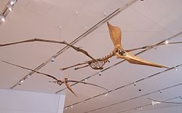

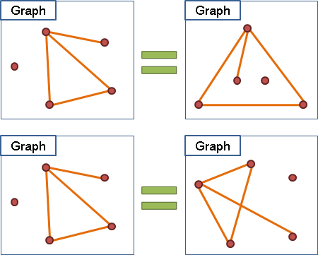


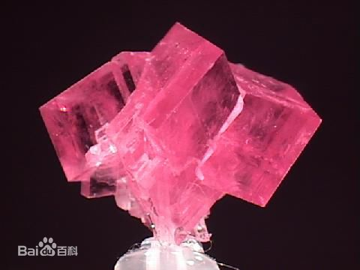
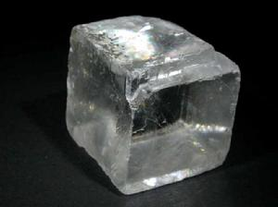
Isomorphism (同構)
Biology
Graph
Chemistry
Notes:
Isomorphism
【生】異種同形係指成功存活的有機體，其活動模式會為其他有機體倣效。
Pterosaur
【數】同型性
【化】化學式相似的物質形成結構類型相同的晶體的現象

Slide 21
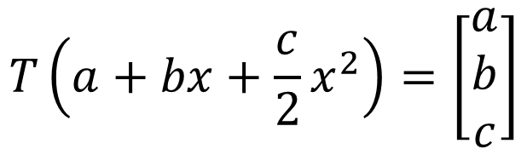
Isomorphism
W
V
Let V and W be vector space.
A linear transformation T: V→W is called an isomorphism if it is one-to-one and onto
  Invertible linear transform
  W and V are isomorphic.
Example 1: U: M_{m×n} → M_{n×m} defined by U(A) = A^{T}.
Example 2: T: P₂ → R³
$$T\left(a+bx+\frac{c}{2}x^{2}\right)=\left[\begin{aligned}a \\ b \\ c\end{aligned}\right]$$

Slide 22
Basis
A basis for subspace V is a linearly independent generation set of V.

Slide 23
Independent
Example
Example
S = {x² - 3x + 2, 3x² − 5x, 2x − 3} is a subset of P_{2.}
Is it linearly independent?
No
is a subset of 2x2 matrices.
Is it linearly independent?
implies that a = b = c = 0
Yes

Slide 24
Independent
If {v₁, v₂, ……, v_{k}} are L.I., and T is an isomorphism, {T(v₁), T(v₂), ……, T(v_{k})} are L.I.
Example
Example
The infinite vector set {1, x, x², ☹, x^{n}, ☹}
Is it linearly independent?
Σ_{i}c_{i}x^{i} = 0 implies c_{i} = 0 for all i.
Yes
S = {e^{t}, e^{2t}, e^{3t}}
Is it linearly independent?
Yes
ae^{t} + be^{2t} + ce^{3t} = 0
a + b + c = 0
ae^{t} + 2be^{2t} + 3ce^{3t} = 0
a + 2b + 3c = 0
ae^{t} + 4be^{2t} + 9ce^{3t} = 0
a + 4b + 9c = 0

Slide 25
Basis
Example
Example
For the subspace of all 2 x 2 matrices,
The basis is
Dim = 4
S = {1, x, x², ☹, x^{n}, ☹} is a basis of P.
Dim = inf

Slide 26
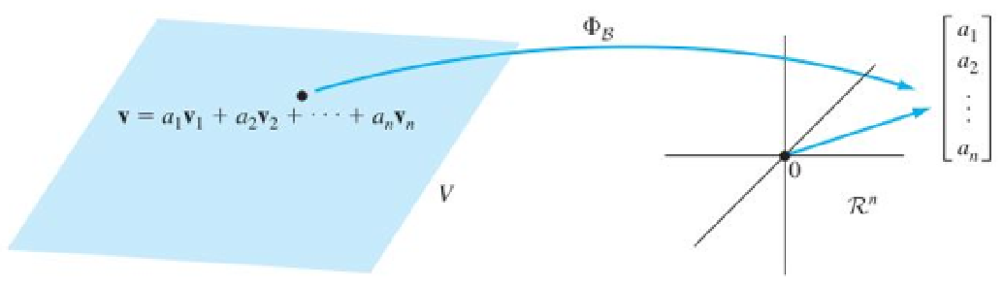

Vector Representation of Object
Coordinate Transformation
basis
P_{n}:
Basis: {1, x, x², ☹, x^{n}}
$$\left[\begin{aligned}a_{0} \\ a_{1} \\ ⋮ \\ a_{n}\end{aligned}\right]$$
$$p\left(x\right)=a_{0}+a_{1}x+⋯+a_{n}x^{n}$$

Slide 27




Matrix Representation of Linear Operator
Example:
  D (derivative): P₂ → P₂
Represent it as a matrix
$$\left[\begin{aligned}2 \\ −3 \\ 5\end{aligned}\right]$$
$$\left[\begin{aligned}−3 \\ 10 \\ 0\end{aligned}\right]$$
vector
vector
Multiply a matrix
$$2−3x+5x^{2}$$
polynomial
polynomial
$$−3+10x$$
Derivative

Slide 28













Matrix Representation of Linear Operator
Example:
  D (derivative): P₂ → P₂
Represent it as a matrix
$$\left[\begin{aligned}0 \\ 1 \\ 0\end{aligned}\right]$$
$$\left[\begin{aligned}0 \\ 0 \\ 0\end{aligned}\right]$$
$$\left[\begin{aligned}1 \\ 0 \\ 0\end{aligned}\right]$$
$$\left[\begin{aligned}0 \\ 2 \\ 0\end{aligned}\right]$$
$$\left[\begin{aligned}1 \\ 0 \\ 0\end{aligned}\right]$$
$$\left[\begin{aligned}0 \\ 0 \\ 1\end{aligned}\right]$$
vector
vector
Multiply a matrix
$$\left[\begin{matrix}0 & 1 & 0 \\ 0 & 0 & 2 \\ 0 & 0 & 0\end{matrix}\right]$$
$$1$$
$$0$$
$$x$$
polynomial
polynomial
$$1$$
Derivative
$$x^{2}$$
2$x$

Slide 29






Matrix Representation of Linear Operator
$$\left[\begin{matrix}0 & 1 & 0 \\ 0 & 0 & 2 \\ 0 & 0 & 0\end{matrix}\right]$$
$$\left[\begin{aligned}5 \\ −4 \\ 3\end{aligned}\right]$$
Example:
  D (derivative): P₂ → P₂
Represent it as a matrix
Not invertible
$$\left[\begin{aligned}5 \\ −4 \\ 3\end{aligned}\right]$$
$$\left[\begin{aligned}−4 \\ 6 \\ 0\end{aligned}\right]$$
vector
vector
Multiply a matrix
$$\left[\begin{matrix}0 & 1 & 0 \\ 0 & 0 & 2 \\ 0 & 0 & 0\end{matrix}\right]$$
$$5−4x+3x^{2}$$
polynomial
polynomial
$$−4+6x$$
Derivative

Slide 30










Matrix Representation of Linear Operator
Example:
  D (derivative): Function set F → Function set F
  Basis of F is $\left\{e^{t}\cos{t},e^{t}\sin{t}\right\}$
invertible
$$\left[\begin{aligned}1 \\ 0\end{aligned}\right]$$
$$\left[\begin{aligned}0 \\ 1\end{aligned}\right]$$
vector
vector
$$\left[\begin{aligned}1 \\ −1\end{aligned}\right]$$
$$\left[\begin{aligned}1 \\ 1\end{aligned}\right]$$
Multiply a matrix
$$\left[\begin{matrix}1 & 1 \\ −1 & 1\end{matrix}\right]$$
Function in F
Function in F
Derivative

Slide 31


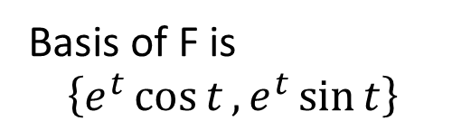


Matrix Representation of Linear Operator
Basis of F is
$$\left\{e^{t}\cos{t},e^{t}\sin{t}\right\}$$
$$\left[\begin{matrix}1/2 & −1/2 \\ 1/2 & 1/2\end{matrix}\right]$$
$$\left[\begin{aligned}−1/2 \\ 1/2\end{aligned}\right]$$
$$\left[\begin{aligned}0 \\ 1\end{aligned}\right]$$
vector
vector
Multiply a matrix
$$\left[\begin{matrix}1 & 1 \\ −1 & 1\end{matrix}\right]$$
Antiderivative
Function in F
Function in F
Derivative

Slide 32
Eigenvalue and Eigenvector
$T\left(v\right)=λv$, $v≠0$, v is eigenvector, $λ$ is eigenvalue

Slide 33

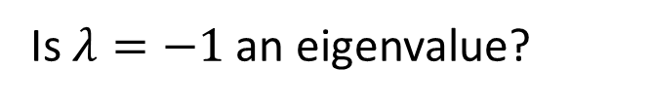
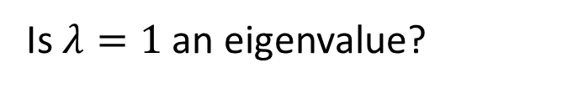


Eigenvalue and Eigenvector
Consider derivative (linear transformation, input & output are functions)
Consider Transpose (also linear transformation, input & output are functions)
Is $f\left(t\right)=e^{at}$ an “eigenvector”?
What is the “eigenvalue”?
Every scalar is an eigenvalue of derivative.
Is $λ=1$ an eigenvalue?
Symmetric:
Symmetric matrices form the eigenspace
$$A^{T}=A$$
Is $λ=−1$ an eigenvalue?
Skew-symmetric:
Skew-symmetric matrices form the eigenspace.
$$A^{T}=−A$$
Notes:
A^T = lambda A
ATT = A = lable AT = label label A

Slide 34
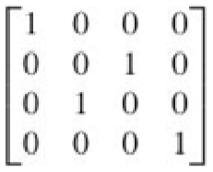






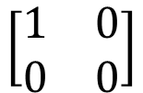

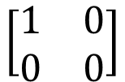

Consider Transpose of 2x2 matrices
$$\left[\begin{aligned}1 \\ 0 \\ 0 \\ 0\end{aligned}\right]$$
$$\left[\begin{aligned}0 \\ 1 \\ 0 \\ 0\end{aligned}\right]$$
$$\left[\begin{aligned}0 \\ 0 \\ 1 \\ 0\end{aligned}\right]$$
$$\left[\begin{aligned}0 \\ 0 \\ 0 \\ 1\end{aligned}\right]$$
$$\left[\begin{aligned}1 \\ 0 \\ 0 \\ 0\end{aligned}\right]$$
$$\left[\begin{aligned}0 \\ 0 \\ 1 \\ 0\end{aligned}\right]$$
$$\left[\begin{aligned}0 \\ 1 \\ 0 \\ 0\end{aligned}\right]$$
$$\left[\begin{aligned}0 \\ 0 \\ 0 \\ 1\end{aligned}\right]$$
vector
vector
What are the eigenvalues?
$$\left[\begin{matrix}1 & 0 \\ 0 & 0\end{matrix}\right]$$
2x2 matrices
2x2 matrices
$$\left[\begin{matrix}1 & 0 \\ 0 & 0\end{matrix}\right]$$
transpose

Slide 35





Eigenvalue and Eigenvector
Consider Transpose of 2x2 matrices
Matrix representation of transpose
Characteristic polynomial
$${\left(t−1\right)}^{3}\left(t+1\right)$$
$$λ=1$$
$$λ=−1$$
Symmetric matrices
Skew-symmetric matrices
$$\left[\begin{matrix}a & b \\ b & c\end{matrix}\right]$$
$$\left[\begin{matrix}0 & a \\ −a & 0\end{matrix}\right]$$
Dim=3
Dim=1

Slide 36
Inner Product

Slide 37
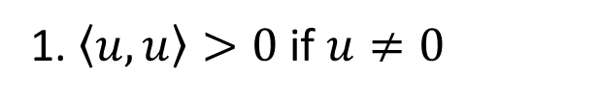


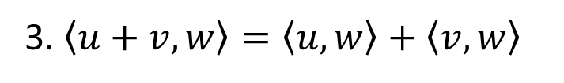
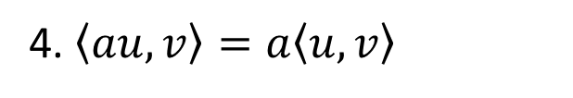
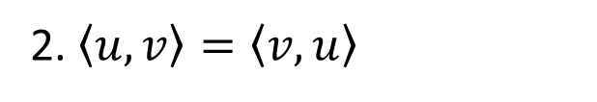
Inner Product
Norm (length):
$$\left\|v\right\|=\sqrt{\left\langle v,v\right\rangle }$$
Orthogonal:
Inner product is zero
$$\left\langle u,v\right\rangle$$
“vector” v
Inner Product
scalar
“vector” u
For any vectors u, v and w, and any scalar a, the following axioms hold:
1. $\left\langle u,u\right\rangle >0$ if $u≠0$
3. $\left\langle u+v,w\right\rangle =\left\langle u,w\right\rangle +\left\langle v,w\right\rangle$
2. $\left\langle u,v\right\rangle =\left\langle v,u\right\rangle$
4. $\left\langle au,v\right\rangle =a\left\langle u,v\right\rangle$
Dot product is a special case of inner product
Can you define other inner product for normal vectors?

Slide 38


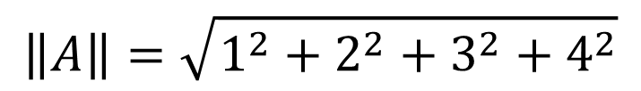


Inner Product
Inner Product of Matrix
Frobenius inner product
$\left\langle A,B\right\rangle =trace\left(AB^{T}\right)$
$=trace\left(BA^{T}\right)$
Element-wise multiplication
$$A=\left[\begin{matrix}1 & 2 \\ 3 & 4\end{matrix}\right]$$
$$\left\|A\right\|=\sqrt{1^{2}+2^{2}+3^{2}+4^{2}}$$

Slide 39


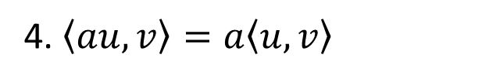
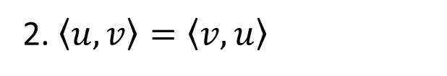
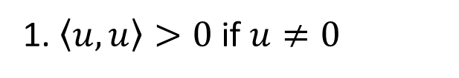
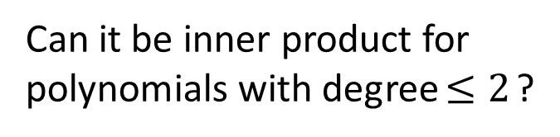
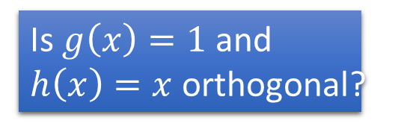
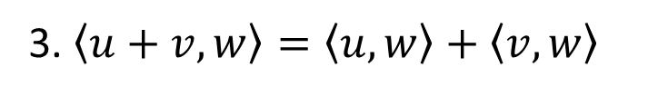
Inner Product
1. $\left\langle u,u\right\rangle >0$ if $u≠0$
2. $\left\langle u,v\right\rangle =\left\langle v,u\right\rangle$
3. $\left\langle u+v,w\right\rangle =\left\langle u,w\right\rangle +\left\langle v,w\right\rangle$
4. $\left\langle au,v\right\rangle =a\left\langle u,v\right\rangle$
Inner product for general functions
Is $g\left(x\right)=1$ and $h\left(x\right)=x$ orthogonal?
Can it be inner product for general functions?
Can it be inner product for polynomials with degree$≤2$?

Slide 40









Orthogonal/Orthonormal Basis
Let u be any vector, and w is the orthogonal projection of u on subspace W.
Let $S=\left\{v_{1},v_{2},⋯,v_{k}\right\}$ be an orthogonal basis of W.
Let $S=\left\{v_{1},v_{2},⋯,v_{k}\right\}$ be an orthonormal basis of W.
$$w=c_{1}v_{1}+c_{2}v_{2}+⋯+c_{k}v_{k}$$
$$\frac{u∙v_{1}}{{\left\|v_{1}\right\|}^{2}}$$
$$\frac{u∙v_{2}}{{\left\|v_{2}\right\|}^{2}}$$
$$\frac{u∙v_{k}}{{\left\|v_{k}\right\|}^{2}}$$
$$w=c_{1}v_{1}+c_{2}v_{2}+⋯+c_{k}v_{k}$$
$$u∙v_{1}$$
$$u∙v_{2}$$
$$u∙v_{k}$$

Slide 41


Orthogonal Basis
Let $\left\{u_{1},u_{2},⋯,u_{k}\right\}$ be a basis of a subspace V. How to transform $\left\{u_{1},u_{2},⋯,u_{k}\right\}$ into an orthogonal basis $\left\{v_{1},v_{2},⋯,v_{k}\right\}$?
Gram-Schmidt
Process
Then $\left\{v_{1},v_{2},⋯,v_{k}\right\}$ is an orthogonal basis for W
After normalization, you can get orthonormal basis.

Slide 42







Orthogonal/Orthonormal Basis
Find orthogonal/orthonormal basis for P₂
  Define an inner product of P₂ by
  Find a basis {1, x, x²}
$$u_{1},u_{2},u_{3}$$
$$v_{1},v_{2},v_{3}$$

Slide 43




Orthogonal/Orthonormal Basis
Find orthogonal/orthonormal basis for P₂
  Define an inner product of P₂ by
  Get an orthogonal basis {1, x, x²-1/3}
Orthonormal Basis

Slide 44

Orthonormal Basis

Slide 45







Fourier Series
For all periodic functions with period $2π$
$$\left\langle f,g\right\rangle =\int_{0}^{2π}{f\left(t\right)g\left(t\right)dt}$$
$$2π$$
$$2π$$
Orthogonal Basis:
Orthonormal Basis:
a
b
$$\frac{\sqrt{a^{2}+b^{2}}}{\sqrt{π}}sin\left(t+arctan\frac{b}{a}\right)$$

Slide 46
工商時間
  預計下個學期 (105 學年度上學期) 開「機器學習」
  Introducing general machine learning methods, not only focus on deep learning
  電機系大二以上就有能力修習
  預計下下個學期 (105 學年度下學期) 開「機器學習及其深層與結構化」
    “深度學習 深度學習”
Notes:
授課時間
作業

